Slide 1


Introduction to
Robotic Process Automation
AUTOMATED CHATBOT TRAINING SYSTEM
Roll No : 220701011
Name : Abishek Sounderajan Rajesh
Guide : Ms.U.Farjana
Dept : Computer Science and Engineering

Slide 2
Abstract
The “Automated Chatbot Training System” is an innovative Robotic Process Automation (RPA) solution that simplifies and accelerates the process of training chatbots by integrating UiPath Studio with Dialogflow. This automation ensures consistent and efficient management of intents and training phrases, significantly reducing manual effort and human error. The system leverages UiPath workflows to automate repetitive steps, such as creating intents, adding training phrases, and managing responses, enabling users to focus on improving chatbot accuracy and user experience. It allows developers to manage large datasets efficiently, handle batch processing seamlessly, and ensure data accuracy through robust validation mechanisms. With its modular design and error-handling capabilities, the system enhances productivity, enabling organizations to develop scalable and user-friendly chatbots suitable for diverse applications, from customer service to healthcare. Chatbots have become indispensable tools across industries for automating interactions and improving customer experiences. However, training chatbots to handle a variety of queries typically involves a tedious and error-prone process of manually creating intents, entering training phrases, and associating appropriate responses.

Slide 3
Need for the Proposed System
For chatbot developers and organizations managing extensive datasets, this system offers a transformative approach. By automating the creation of intents, updating training phrases, and assigning responses in Dialogflow, it minimizes manual intervention while maintaining high precision. To address the overload of repetitive student inquiries, we will develop an AI-powered chatbot using UiPath Studio's Language Understanding Model. The solution will include:
  Chatbot Development.
  Multi-channel Integration
  Intelligent Responses
  Continuous Improvement
  Testing and Deployment

Slide 4
Advantages of the Proposed System
Efficiency and Time-Saving:
  Automates the creation and management of intents, training phrases, and responses, significantly reducing the time required for manual input.
  Streamlines repetitive tasks, enabling faster chatbot deployment and updates.
Scalability:
  Facilitates large-scale chatbot development by handling extensive datasets and automating training processes, making it suitable for businesses with diverse requirements.
  Ensures consistent performance across multiple domains or languages.
Accuracy and Consistency:
  Reduces human errors in intent creation and testing, ensuring uniformity in chatbot responses.
Integration with Dialogflow:
  Seamlessly interfaces with Dialogflow to train and manage chatbots, leveraging its advanced natural language processing (NLP) capabilities.

Slide 5
Literature Survey
Paper 1: "Leveraging Robotic Process Automation (RPA) in Chatbot Training and Intent Management"
Advantages:
  Automates repetitive tasks such as intent creation, training data input, and response mapping, reducing manual errors.
  Enhances chatbot scalability by streamlining updates and training across multiple languages or domains.
  Increases efficiency, allowing developers to focus on improving conversational logic and user experience.
Disadvantages:
  Limited adaptability for context-sensitive interactions requiring nuanced understanding.
  High dependency on structured datasets; struggles with unstructured input data during automation.
  Initial implementation requires significant time and technical expertise for configuring RPA workflows.
Paper 2: "Challenges and Solutions in Automating Chatbot Scalability Using RPA"
Advantages:
  Enables rapid deployment of chatbots in multiple domains by automating data preprocessing and intent classification.
  Reduces operational costs by minimizing human intervention in routine chatbot maintenance tasks.
  Improves accuracy and consistency in conversational flows by automating version control and rollback mechanisms.
Disadvantages:
  Scalability issues in handling domain-specific datasets with complex conversational structures.
  Dependence on external APIs for integrations can lead to delays if API performance is suboptimal.
  Ethical considerations in using automated systems for customer-facing applications without human oversight.

Slide 6
Main Objective
The primary objective of "Automating Chatbot Training with UiPath and Dialogflow" is to revolutionize the chatbot development and training process. By leveraging Robotic Process Automation (RPA), this project aims to automate the creation of intents, the addition of training phrases, and the assignment of responses in Dialogflow. The goal is to provide chatbot developers and organizations with a highly efficient, accurate, and scalable solution for managing large datasets and ensuring consistent training. The "Automating Chatbot Training with UiPath and Dialogflow" system is designed as a transformative solution to address the inefficiencies in training conversational AI. By leveraging UiPath's RPA capabilities, the proposed system automates the creation of intents, the addition of training phrases, and the assignment of responses within Dialogflow. It systematically processes datasets, validates their format, and interacts with Dialogflow APIs to update chatbot configurations efficiently.

Slide 7
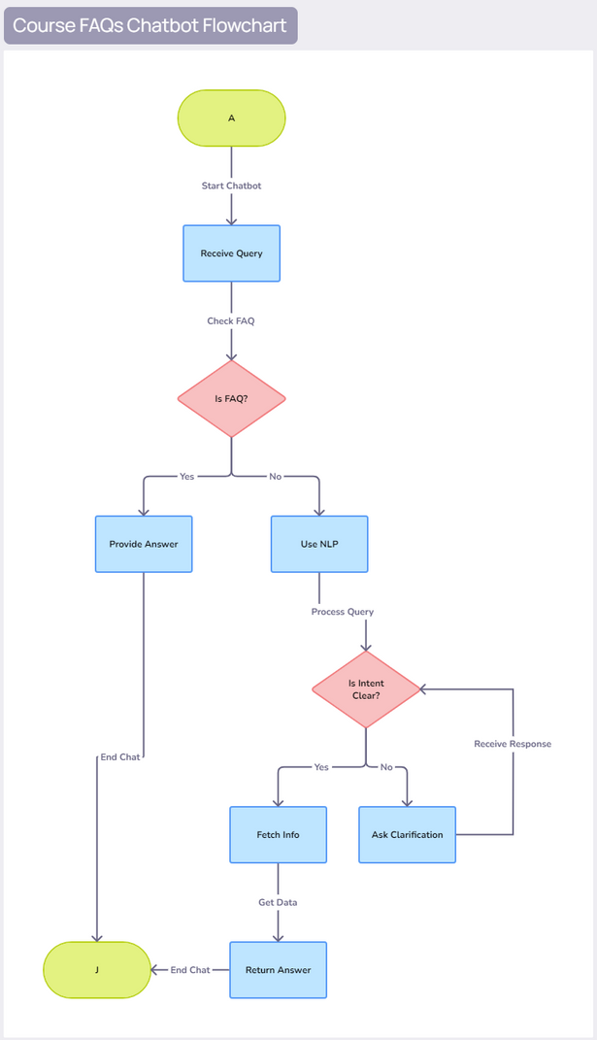
Architecture

Slide 8
System Requirements
Hardware Requirements:
For Development and Execution:
  Processor: Intel Core i5 or higher (or equivalent AMD Ryzen 5 or above)
  RAM: Minimum 8 GB (16 GB recommended for better performance)
  Storage: 256 GB SSD or higher
  Graphics Card: Integrated or Dedicated GPU
Software Requirements:
Operating System:
  Windows 10/11 (64-bit) or Windows Server 2016/2019 for enterprise-level deployment.
  macOS/Linux (if the project components support cross-platform tools).
Development Tools:
  UiPath Studio: For building and running the RPA workflows.
  Dialogflow Console: For chatbot training and configuration.
Third-Party APIs:
  Dialogflow API: For connecting the chatbot backend and automating intent handling.
  Google Sheets API (optional): For managing dynamic datasets if required.
Dependencies and Libraries:
  UiPath Add-ons: Automation libraries and pre-built components for Excel and file handling.

Slide 9
Functional Description
Name of the Module 1
  Short description
DFD / Activity Diagram
Name of the Module 2
  Short description
DFD / Activity Diagram

Slide 10
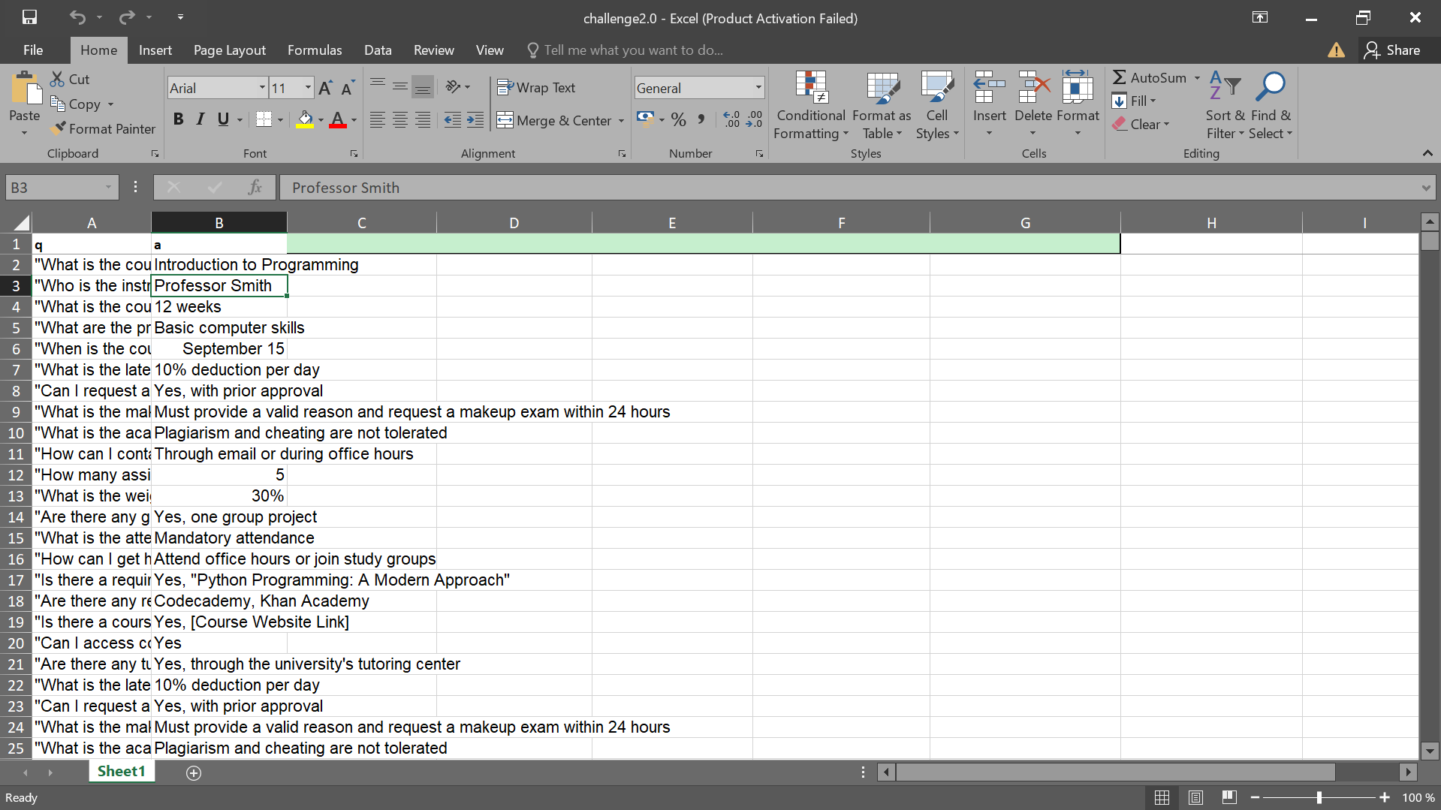
Table Design

Slide 11
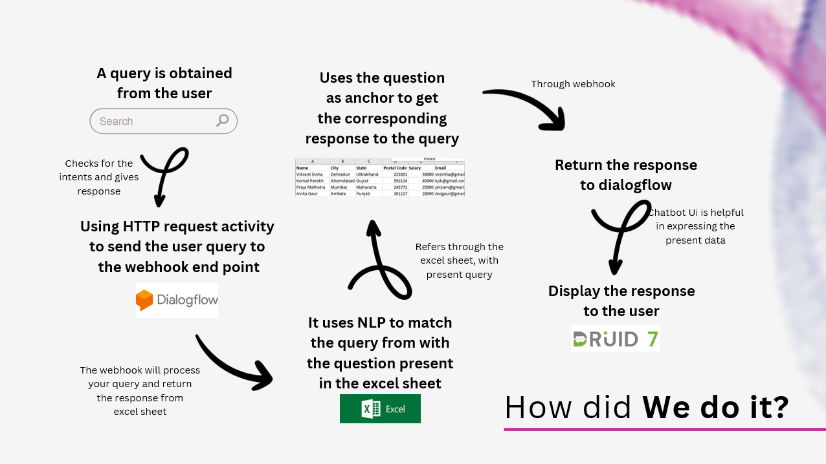
Process Design

Slide 12
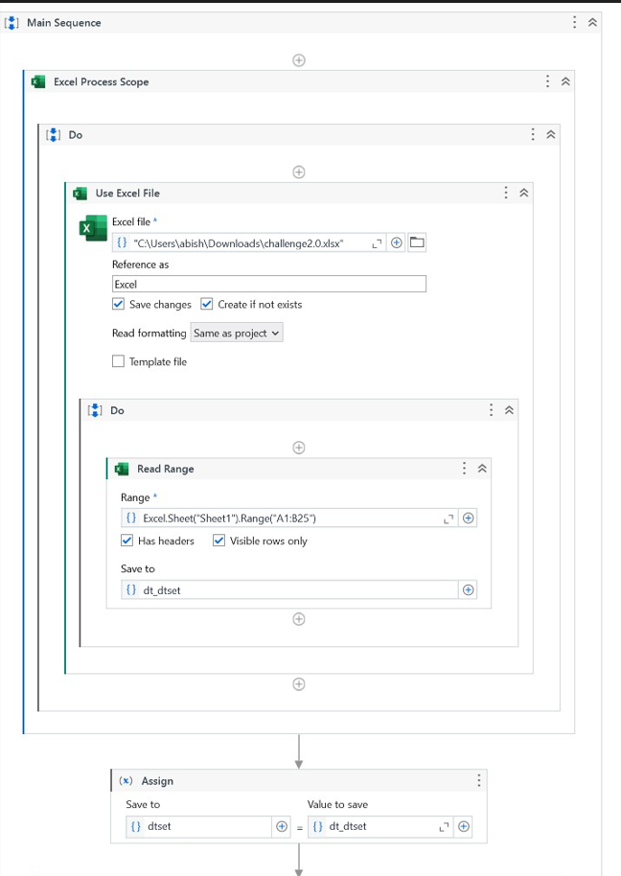
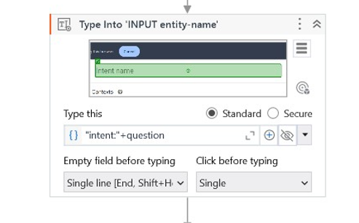
Implementation
Implementation of Excel
Sheet Data extraction
Implementation of
Entering Intents

Slide 13
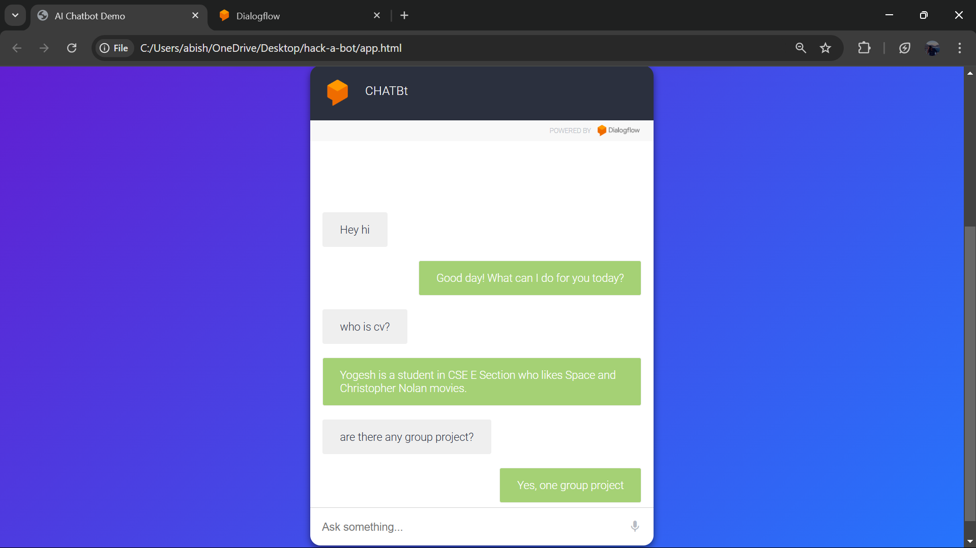
Testing

Slide 14
Conclusions
This "The Automated Chatbot Intent Training and Testing System" transforms the way conversational AI systems are developed and maintained by leveraging UiPath's Robotic Process Automation (RPA). This project addresses the challenges of scaling chatbots, automating intent creation, and ensuring accuracy in training and testing, providing an efficient and systematic solution for developers.
While the system greatly enhances efficiency, challenges may arise when dealing with highly complex or context-sensitive interactions. Continuous improvement through advanced algorithms and integration with emerging AI technologies is essential to tackle these limitations.
Nonetheless, the successful implementation of this project lays a strong foundation for scalable and reliable chatbot solutions, making it a valuable tool for businesses and developers aiming to meet the demands of diverse and dynamic user interactions. This project marks a step forward in automating and optimizing chatbot workflows, contributing to the evolution of conversational AI in the digital age.

Slide 15
Future Enhancement
  Expanded Knowledge Base: Extend the chatbot's capabilities to cover more topics, such as financial aid, campus events, and career services.
  Multilingual Support: Add support for multiple languages to cater to a diverse student body, improving accessibility for international students.
  Integration with Academic Systems: Integrate the chatbot with Learning Management Systems (LMS) and Student Information Systems (SIS) for real-time updates on grades, assignments, and enrollment status.
  Voice Interaction: Incorporate voice recognition technology to allow students to interact with the chatbot through voice commands, enhancing user experience.

Slide 16
References
Kuppusamy, Palanivel & Joseph K, Suresh. (2020). Robotic Process Automation to Smart Education. 3775.
Patil, Dr & Mane, Vinod & Patil, Dr. (2019). Social Innovation in System by using Robotic Process Automation (Rpa). International Journal of Innovative Technology and Exploring Engineering. 8. 3757-3760. 10.35940/ijitee.K2148.0981119.
Ariponnammal, S. and Natarajan, S. (1994) ‘Transport Phonomena of Sm Sel – X Asx’, Pramana – Journal of Physics Vol.42, No.1, pp.421-425.
Barnard, R.W. and Kellogg, C. (1980) ‘Applications of Convolution Operators to Problems in Univalent Function Theory’, Michigan Mach, J., Vol.27, pp.81–94.
Shin, K.G. and Mckay, N.D. (1984) ‘Open Loop Minimum Time Control of Mechanical Manipulations and its Applications’, Proc.Amer.Contr.Conf., San Diego, CA, pp. 1231-1236.

Slide 17
Queries

Slide 18
Demonstration

Slide 19
Thank You

